Slide 1
Markov Chain Monte Carlo
Halle Purdom

Slide 2

MCMC Key Concepts
What does MCMC do?
Solves high dimensional integration and optimization problems
Approximates a posterior distribution of a parameter of interest through random sampling from a probability
Generates posterior distribution of theta
Machine learning, physics, econometrics, statistics
MCMC sampler makes intelligent guesses with high posterior probabilities (low chi-squared)
Input: Data→ Process: MCMC → Output: Posterior
What is a Posterior?
Probability distribution of some parameters of interest given the data and a model (hypothesis)
Posterior = Prior x Likelihood
MCMC as a “black box”
The prior, the input, the domain knowledge matter

Slide 3


Monte Carlo Simulation
Solitaire: Stan Ulam 1946
“Statistical sample to approximate a hard combinatorial problem” (Andrieu et al. 2003)
Draw set of samples from target density p(x), all configurations of a system
Uses repeated random sampling
Draw a random number from a distribution
The proposal distribution is the normal distribution in this case
Proposal distribution remains constant
StataCorp LLC. Introduction to Bayesian statistics, part 2: MCMC and the Metropolis–Hastings algorithm.
Retrieved from https://www.youtube.com/watch?v=OTO1DygELpY&ab_channel=StataCorpLLC.

Slide 4
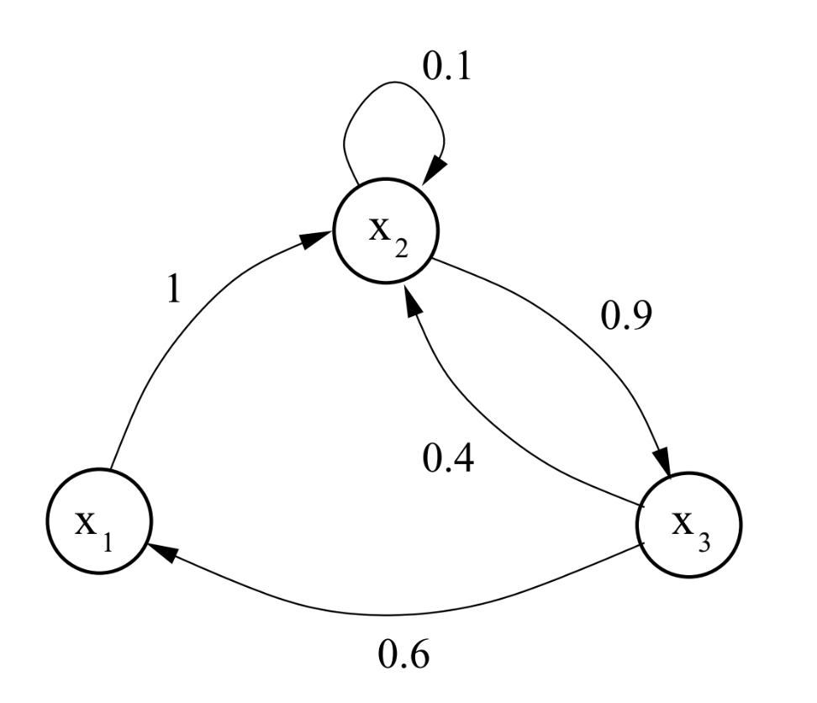
Markov Chain Monte Carlo
Markov chains change depending on:
Current state
Fixed transition matrix
Chain converges to p(x) as long as transition matrix follows:
Irreducibility
At any state, positive probability of moving to any other state
Aperiodicity
Chain doesn’t get stuck in cycles
Transition Graph for Markov Chain. Figure from Andrieu et al. (2003).

Slide 5

Markov Chain Monte Carlo
Chain of numbers where each number is dependent only on the previous number
Each normal distribution mean that the next random sample is taken from equals the previous value of theta
Sometimes called a Random Walk
StataCorp LLC. Introduction to Bayesian statistics, part 2: MCMC and the Metropolis–Hastings algorithm.
Retrieved from https://www.youtube.com/watch?v=OTO1DygELpY&ab_channel=StataCorpLLC.

Slide 6


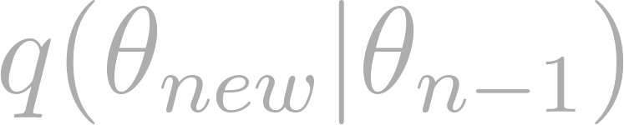
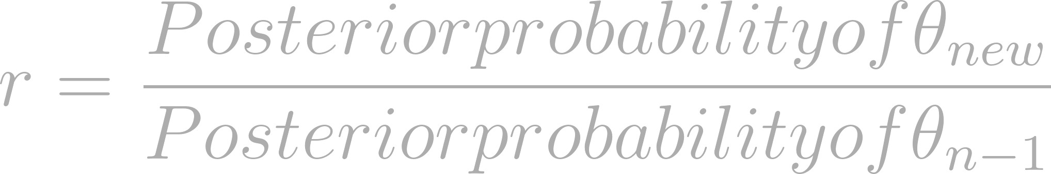

Metropolis-Hastings Algorithm
Hastings generalized the Metropolis Algorithm (1953) in 1970
Which proposed values of theta do we accept, and which do we reject?
Remember that:
Posterior = Prior x Likelihood
Technically divided by normalization factor (not dependent on theta)
We don’t need to know the posterior probability
Proposal Distribution q(x)
Should accept 25-50% proposed candidates - tuned in algorithms
Select initial value
Draw new value of from proposal distribution:
Moves towards candidate with acceptance probability A(x, x ) = min{1, [p(x)q(x|x)]−1 p(x )q(x|x)}, otherwise it remains at x.
r >=1
Accept and set as next step in chain
0 > r > 1
Accept and set as next step in chain with probability = r
Reject and set next step to be with probability 1-r

Slide 7
Metropolis-Hastings MCMC Example from StataCorp LLC
StataCorp LLC. Introduction to Bayesian statistics, part 2: MCMC and the Metropolis–Hastings algorithm.
Retrieved from https://www.youtube.com/watch?v=OTO1DygELpY&ab_channel=StataCorpLLC.

Slide 8
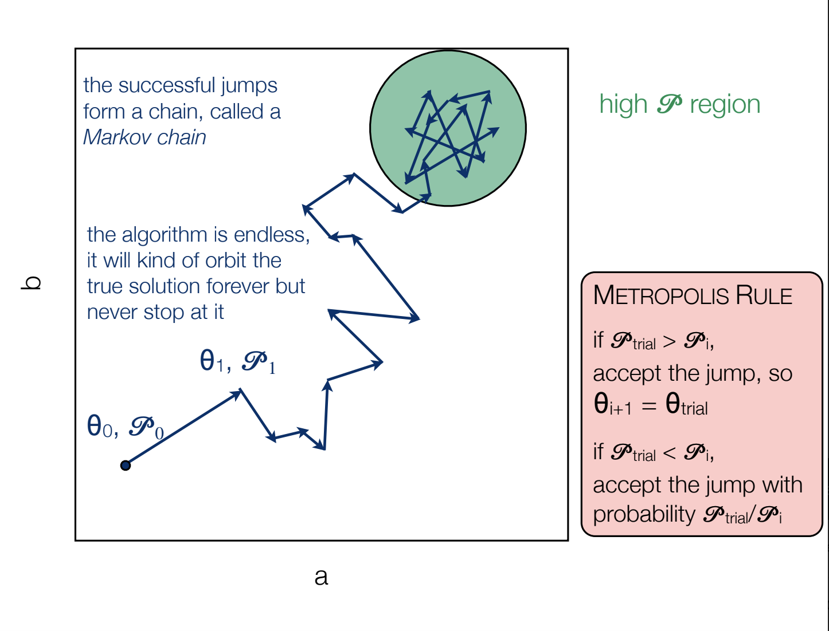
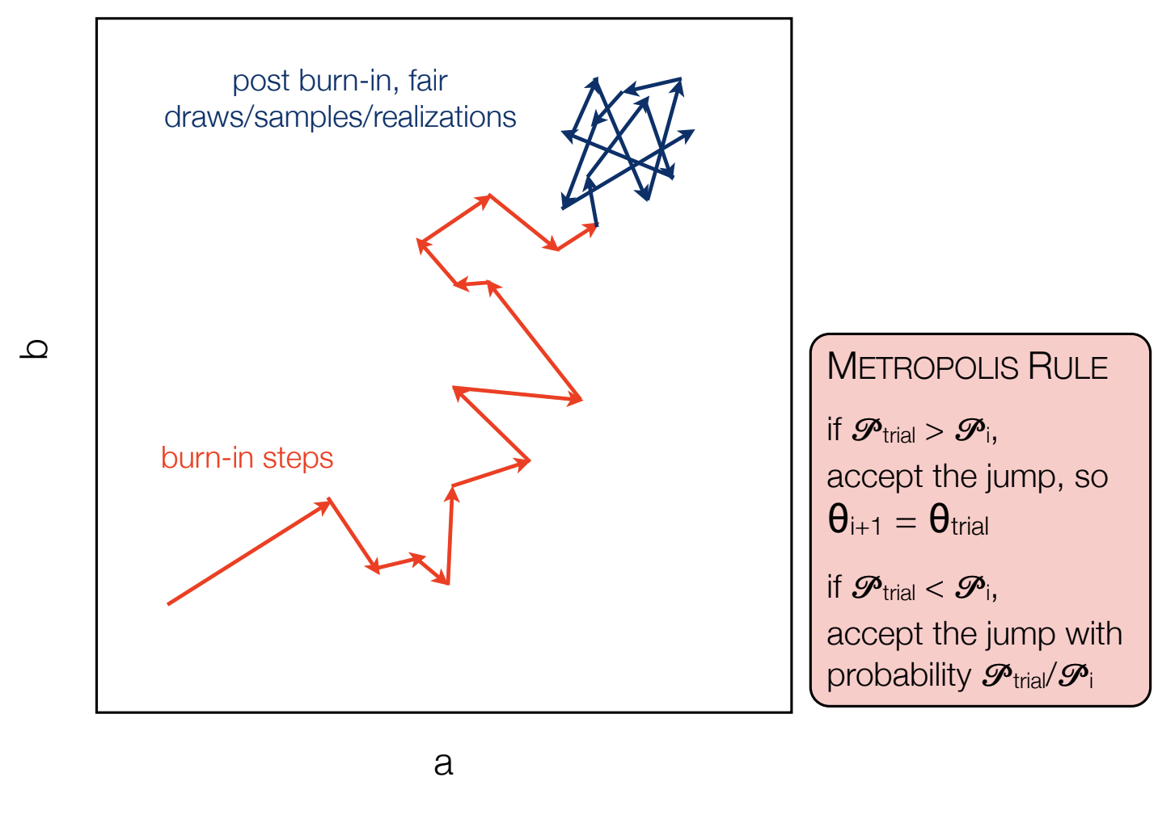
Another Example & Burn In Period
David Kipping. Sagan Workshop 2016. A Beginner’s Guide to Monte Carlo Markov Chain MCMC Analysis.

Slide 9
References
Metropolis, Nicholas, et al. "Equation of state calculations by fast computing machines." The journal of chemical physics 21.6 (1953): 1087-1092.
Hastings, W. Keith. "Monte Carlo sampling methods using Markov chains and their applications." (1970): 97-109.
Andrieu, Christophe, et al. "An introduction to MCMC for machine learning." Machine learning 50.1 (2003): 5-43.
StataCorp LLC. Introduction to Bayesian statistics, part 2: MCMC and the Metropolis–Hastings algorithm. Retrieved from https://www.youtube.com/watch?v=OTO1DygELpY&ab_channel=StataCorpLLC.
David Kipping. Sagan Workshop 2016. A Beginner’s Guide to Monte Carlo Markov Chain MCMC Analysis. Retrieved from https://www.youtube.com/watch?v=vTUwEu53uzs&ab_channel=SaganSummerWorkshop.
Machine Learning TV. Understanding Metropolis-Hastings algorithm. Retrieved from https://www.youtube.com/watch?v=0lpT-yveuIA&ab_channel=MachineLearningTV.

